Slide 1

Finding Similar Type of Names | Fuzzy Search

Slide 2
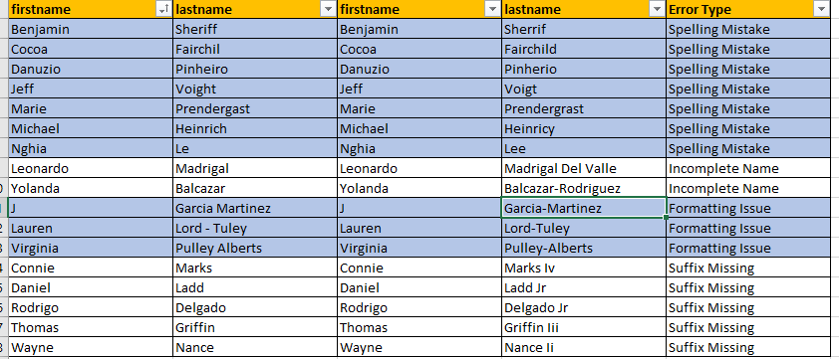
Finding Similar Type of Names | Fuzzy Search
Typing mistake is a very common mistake which reviewer do while capturing the names which leads to inconsistency in Data.
Problem Statement:
Finding all kind of error types which described in the below table e.g. Spelling Mistake, Incomplete Name, Formatting Issue, Suffix Missing.

Slide 3

How to solve it?
SOUNDEX() Function can find the inconsistency in names.
SOUNDEX() can evaluate the similarity of two names.
Note:
SOUNDEX() only works well when we do have 1 or 2 tokens. Names generally contains 1-2 tokens so it works fine with Name. But if we want to find the similar names for company then it's not that useful as it contains multiple tokens.

Slide 4
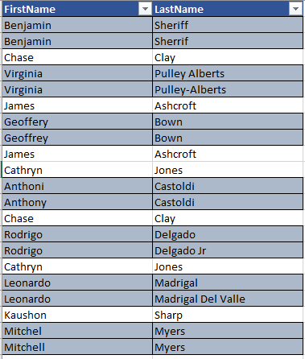
Coding
Case1 : FirstName is exact same but LastName is similar type
Case2: LastName is exact same but FirstName is similar type
Data
Highlighted cells are inconsistent data.
Benjamin Sheriff and Benjamin Sherrif where FirstName is same but any of the LastName has spelling error. Likewise there are many error in this data like formatting issue, incomplete name

Slide 5
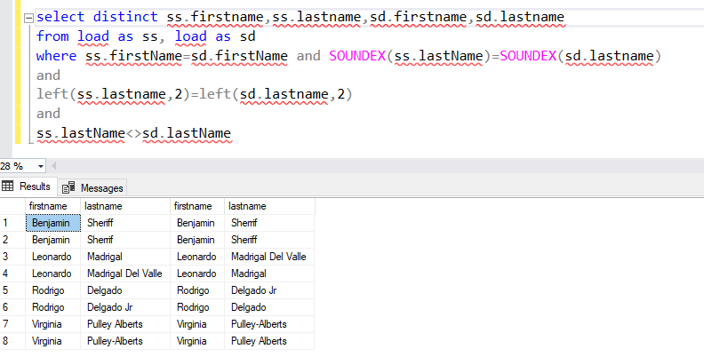
Case1 : FirstName is exact same but LastName is similar type:
select distinct ss.firstname,ss.lastname,sd.firstname,sd.lastname
from load as ss, load as sd
where ss.firstName=sd.firstName
and
SOUNDEX(ss.lastName)=SOUNDEX(sd.lastname)
and
left(ss.lastname,2)=left(sd.lastname,2)
and
ss.lastName<>sd.lastName

Slide 6
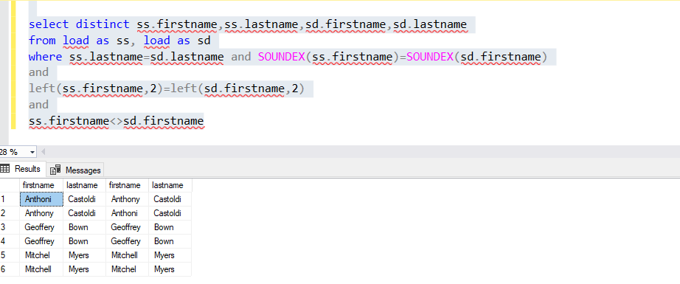
Case2 : LastName is exact same but FirstName is similar type:
select distinct ss.firstname,ss.lastname,sd.firstname,sd.lastname
from load as ss, load as sd
where ss. lastName =sd. lastName
and
SOUNDEX(ss.firstName)=SOUNDEX(sd. firstName)
and
left(ss. firstName,2)=left(sd. firstName,2)
and
ss. firstName <>sd. firstName

Slide 7
THANK YOU

